Slide 1
Loss Function
Guan Wang

Slide 2

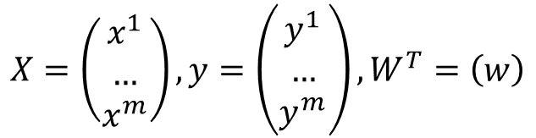
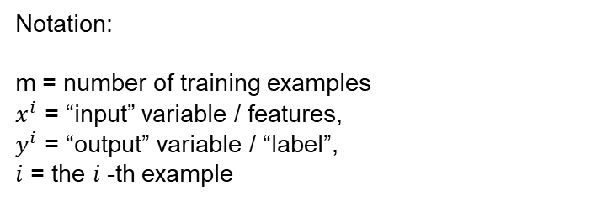
Recap
Area (x) | Price($) in million (y)
742 | 1.33
896 | 1.22
996 | 1.22
750 | 1.22
742 | 1.14
… | …
$$X=\left(\begin{matrix}x^{1} \\ … \\ x^{m}\end{matrix}\right),y=\left(\begin{matrix}y^{1} \\ … \\ y^{m}\end{matrix}\right),W^{T}=\left(w\right)$$
$$y^{i}=f\left(x^{i};w,b\right)=wx^{i}+b$$
Notation:
m = number of training examples
$x^{i}$ = “input” variable / features,
$y^{i}$ = “output” variable / “label”,
$i$ = the $i$-th example

Slide 3
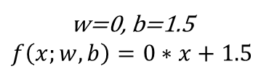

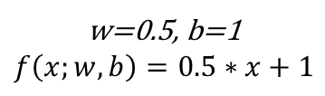
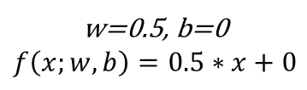
Parameter Selection
$$f\left(x;w,b\right)=wx+b$$
w=0, b=1.5
$$f\left(x;w,b\right)=0∗x+1.5$$
3
2
w=0.5, b=0
$$f\left(x;w,b\right)=0.5∗x+0$$
1
0
1
2
3
w=0.5, b=1
$$f\left(x;w,b\right)=0.5∗x+1$$

Slide 4


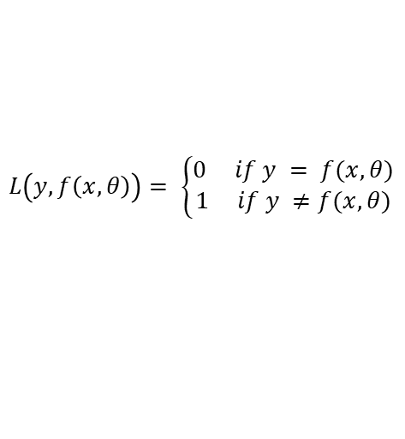

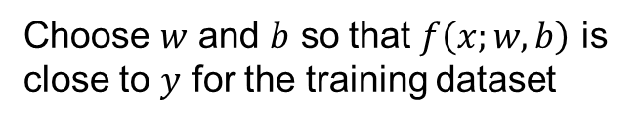
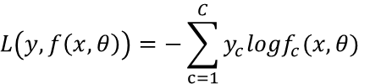
Loss Function
$$L\left(y,f\left(x, θ\right)\right)= \left\{\begin{aligned}0 if y = f(x,θ) \\ 1 if y ≠f(x,θ)\end{aligned}\right.$$
Loss Function
0-1 loss function
Quadratic loss function
Cross-Entropy loss function
$$L\left(y,f\left(x, θ\right)\right)=\frac{1}{2}{(y−f(x,θ))}^{2}$$
$$θ=(w,b)$$
$$L\left(y,f\left(x, θ\right)\right)=−\sum_{c=1}^{C}{y_{c}{logf}_{c}(x,θ)}$$
Choose $w$ and $b$ so that $f\left(x;w,b\right)$ is close to $y$ for the training dataset
$$f\left(x;w,b\right)=wx+b$$

Slide 5


Objective Function
Loss Function
0-1 loss function
Quadratic loss function
Cross-Entropy loss function
$$L\left(y,f\left(x;w,b\right)\right)=\frac{1}{2}{(y−f(x;w,b))}^{2}$$
$$\underset{w,b}{minimize}{(\frac{1}{2M}\sum_{i=1}^{M}{{\left(y^{i}−f\left(x^{i};w,b\right)\right)}^{2}})}$$
Objective function
Choose $w$ and $b$ so that $f\left(x;w,b\right)$ is close to $y$ for the training dataset

Slide 6
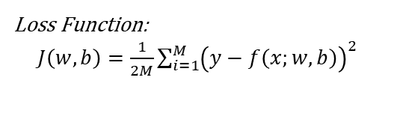

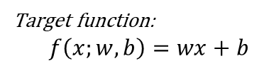
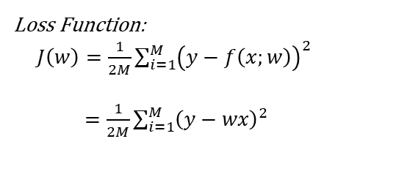


Loss Function
Target function:
$$f\left(x;w,b\right)=wx+b$$
Target function:$f\left(x;w\right)=wx$
Loss Function:
$J\left(w\right)=\frac{1}{2M}\sum_{i=1}^{M}{{\left(y−f\left(x;w\right)\right)}^{2}}$
$=\frac{1}{2M}\sum_{i=1}^{M}{{\left(y−wx\right)}^{2}}$
Loss Function:
$J\left(w,b\right)=\frac{1}{2M}\sum_{i=1}^{M}{{\left(y−f\left(x;w,b\right)\right)}^{2}}$
Goal: $\underset{w,b}{minimize}{J\left(w,b\right)}$
Goal: $\underset{w}{minimize}{J\left(w\right)}$

Slide 7



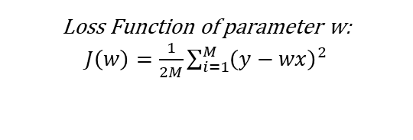



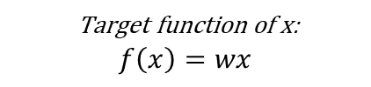









Target function of x:
$$f\left(x\right)=wx$$
Loss Function of parameter w:
$J\left(w\right)=\frac{1}{2M}\sum_{i=1}^{M}{{\left(y−wx\right)}^{2}}$
$$f(x)$$
$$w=1$$
$$J\left(w\right)$$
$$3$$
$$w=0.5$$
$$2$$
$$w=0$$
$$1$$
$$x$$
$$0$$
$$0.5$$
$$1$$
$$1.5$$
$$2$$
$$2.5$$
$$w$$

Slide 8
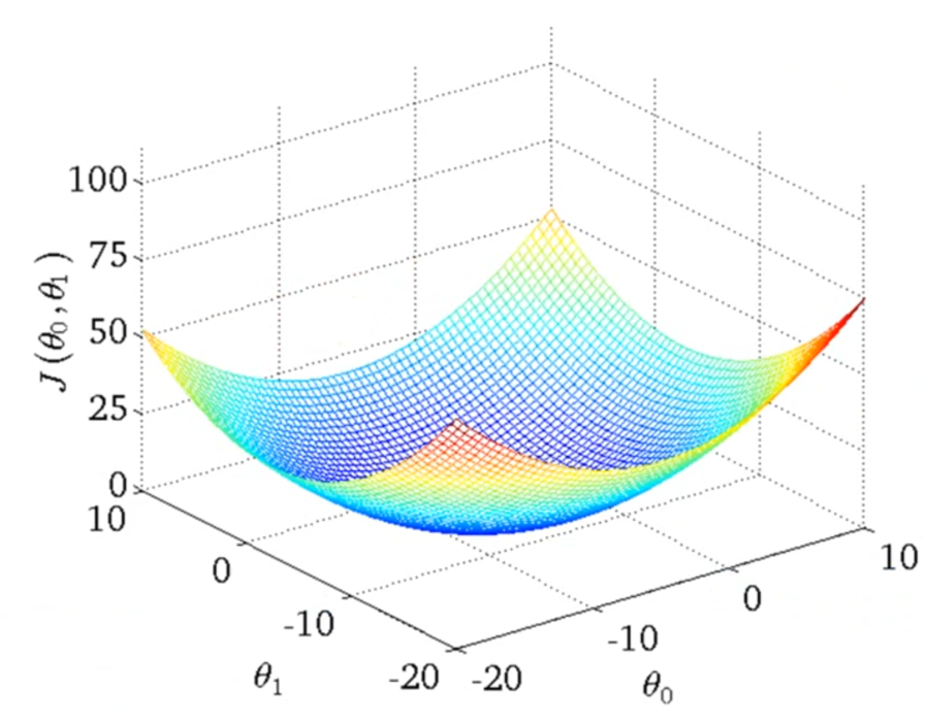

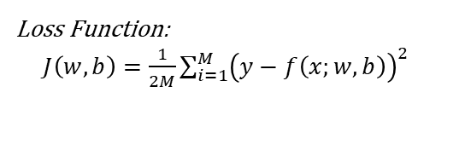

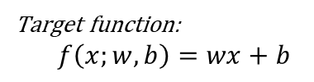


Target function:
$$f\left(x;w,b\right)=wx+b$$
Loss Function:
$J\left(w,b\right)=\frac{1}{2M}\sum_{i=1}^{M}{{\left(y−f\left(x;w,b\right)\right)}^{2}}$
$$J\left(w,b\right)$$
Goal: $\underset{w,b}{minimize}{J\left(w,b\right)}$
$$w$$
$$b$$

Slide 9
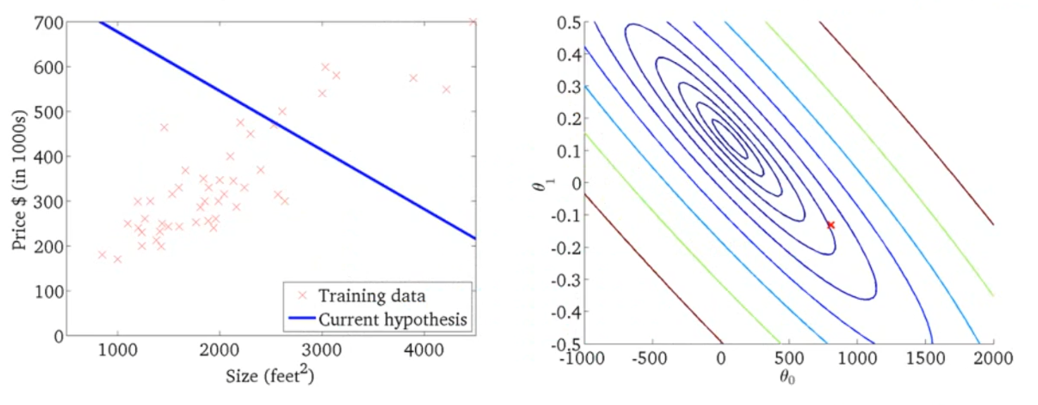


Contour Plot
$$w$$
$$b$$
$$f\left(x;−0.13, 800\right)=−0.13x+800$$

Slide 10
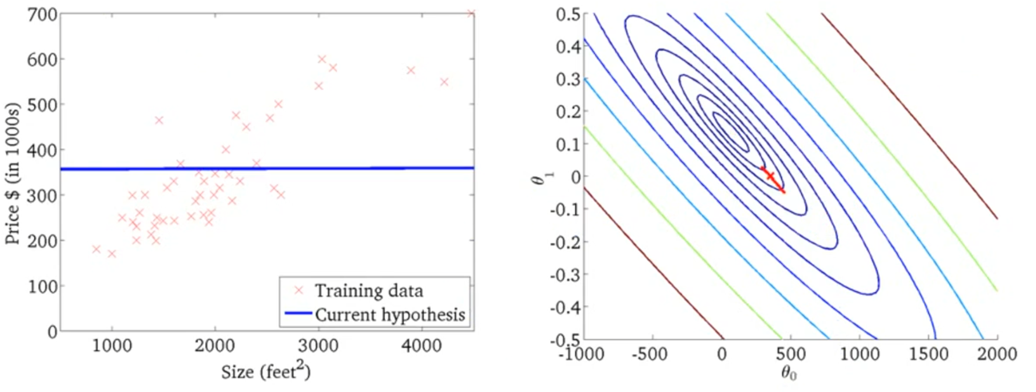


$$w$$
$$b$$
$$f\left(x;0, 360\right)=0x+360$$

Slide 11
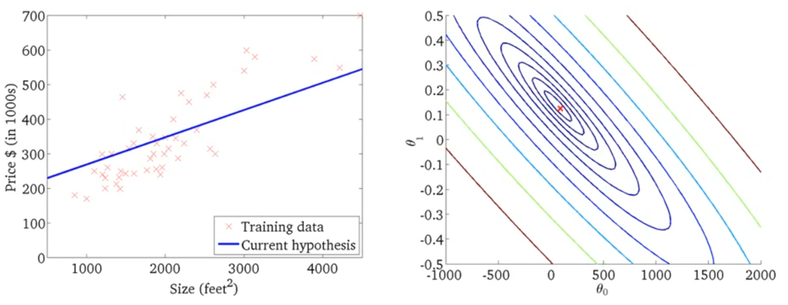


$$w$$
$$b$$
$$f\left(x;0.12, 210\right)=0.12x+210$$

